Slide 1

Predicting Common Scopes
Bijan Seyednasrollah
April 1st, 2021

Slide 2
Background
Seller Requests Offer
Opendoor Sends Offer
Seller Accepts Offer
Opendoor Inspect
Opendoor Charges for Repair
Sale Complete
Seller Withdraw

Slide 3
Problem Statement
Traditional Method: Inspectors estimate the repair cost.
New Method: Can we use data science to eliminate inspection?
What we know:
Every sale is equivalent of $5000 in profit
Every $150 in repair charge increase the withdrawal by 1%
Eliminating inspector’s visit can lead to 5% decline in withdrawal

Slide 4
Data
Features:
House characteristics such as: number of bedrooms, age, location, area, etc.
Target:
Common Scope estimates

Slide 5
Approach
Several possible approaches:
Regression Analysis:
Linear Regression
Lasso Regression
Ridge Regression
Neural Network
AutoML

Slide 6
Approach
Several possible approaches:
Regression Analysis:
Linear Regression
Lasso Regression
Ridge Regression
Neural Network
AutoML
Implemented as customized class: CommonScope(model, params, ...)

Slide 7
Approach
Several possible approaches:
Regression Analysis:
Linear Regression
Lasso Regression
Ridge Regression
Neural Network
AutoML
Deep Learning model built in TensorFlow

Slide 8
Approach
Implemented approaches:
Regression Analysis:
Linear Regression
Lasso Regression
Ridge Regression
Neural Network
AutoML
Google Cloud Platform

Slide 9
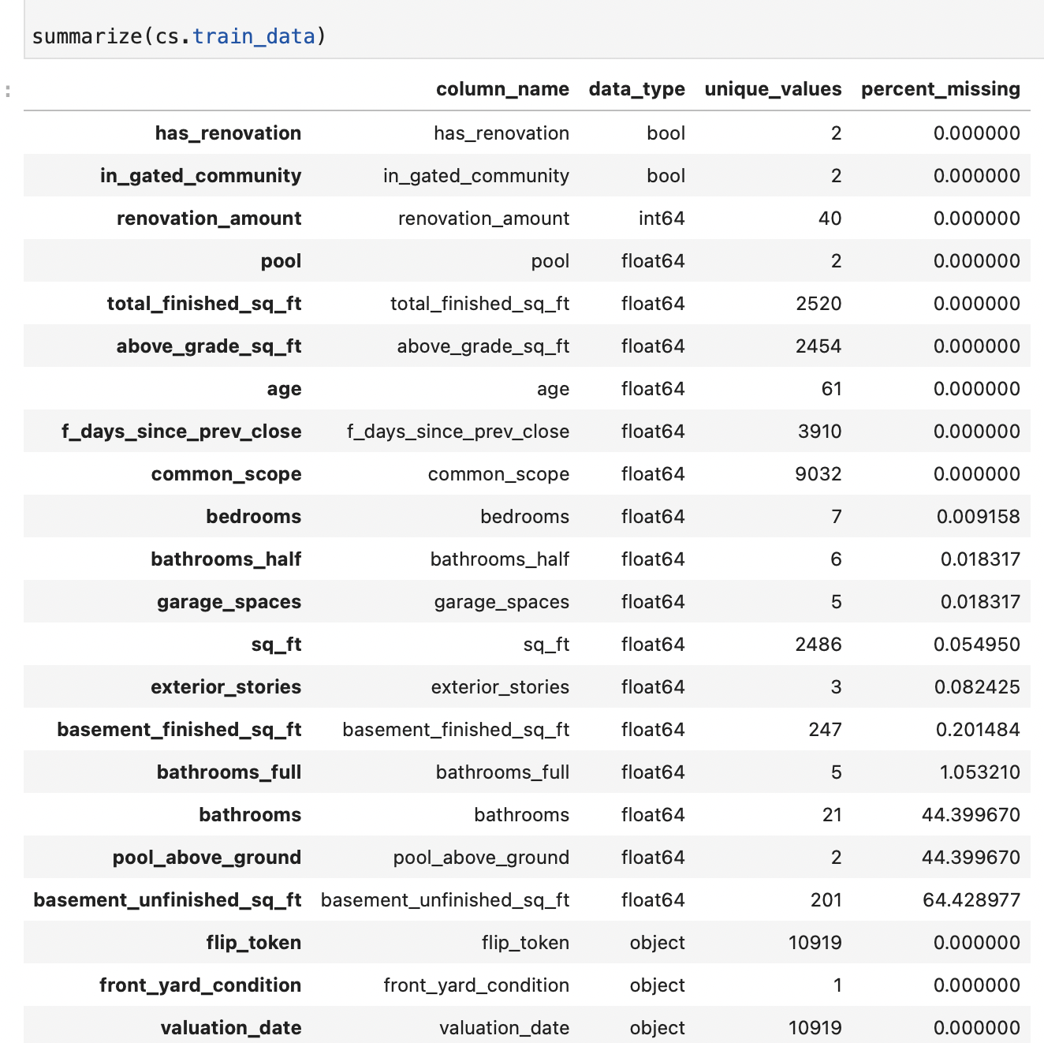
Data / Modeling Challenges
Missing Data Imputation per data type
Multifarious data (various types) boolean, integer, float, categorical, text
Multicollinearity Regularization and Variance Inflation Factor
Positive-Only Target Transformations

Slide 10
Modeling Framework
I developed a Python module featuring the CommonScope class. The CommonScope class contains all the necessary methods to load and preprocess the data, train the model, and predict for new dataset. The class takes care of customized missing data handling and user-defined arguments to control the model.
Inside the class, three regression model are presented: Linear Regression, Lasso Regression and Ridge Regression.
I compared the outcome with results from GCP’s AutoML as well as a customized Neural Network model built in TensorFlow.

Slide 11
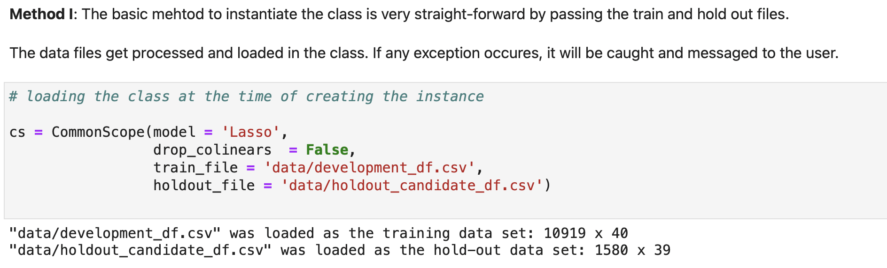
CommonScope Initialization

Slide 12
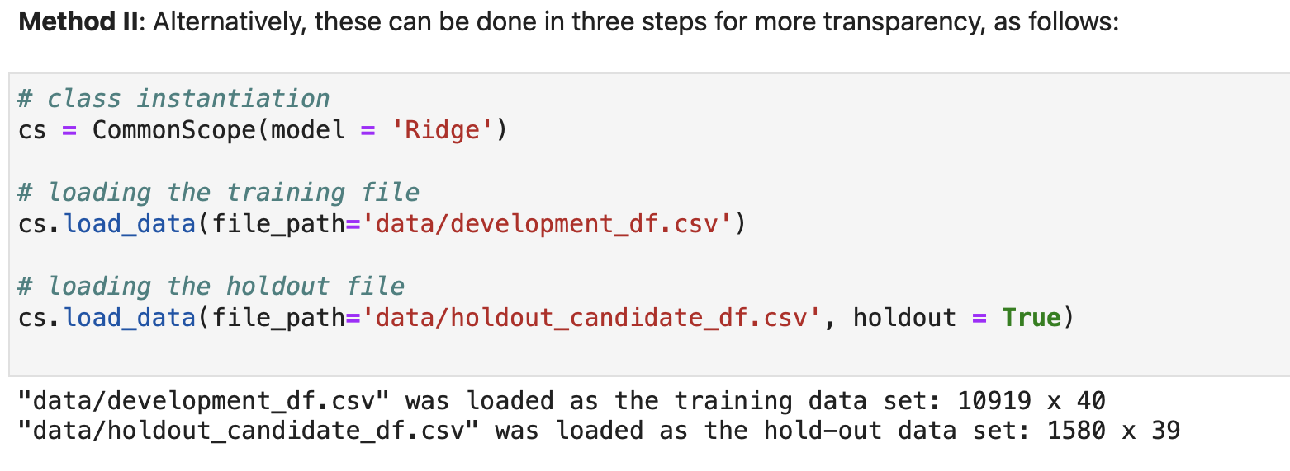
CommonScope Initialization

Slide 13
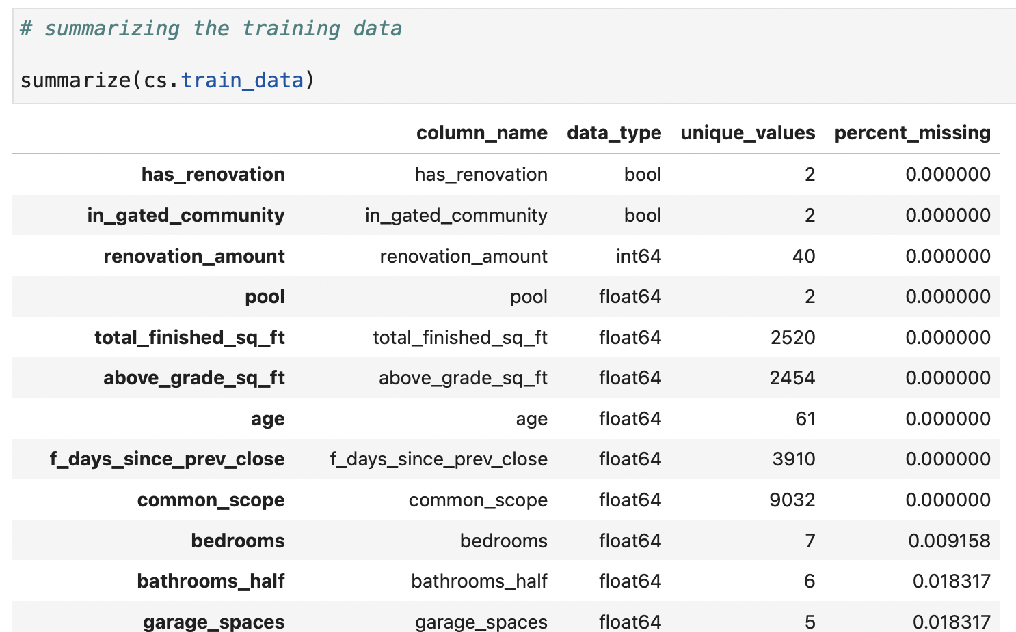
CommonScope Data Exploration

Slide 14
CommonScope Preprocessing
Boolean ⇒ Binary vector, Missing data imputed as False
Integer ⇒ Number, Missing data imputed with median of the training dataset
Float ⇒ Number, Missing data imputed with mean of the training dataset
Categorical ⇒ One-Hot Encoding, Missing data imputed with most-frequent of the training dataset
Text ⇒ Parsed, then transformed to binary matrices, no imputation needed.
Columns with majority as missing were dropped
Non-linear terms were added to improve the performance of the model

Slide 15
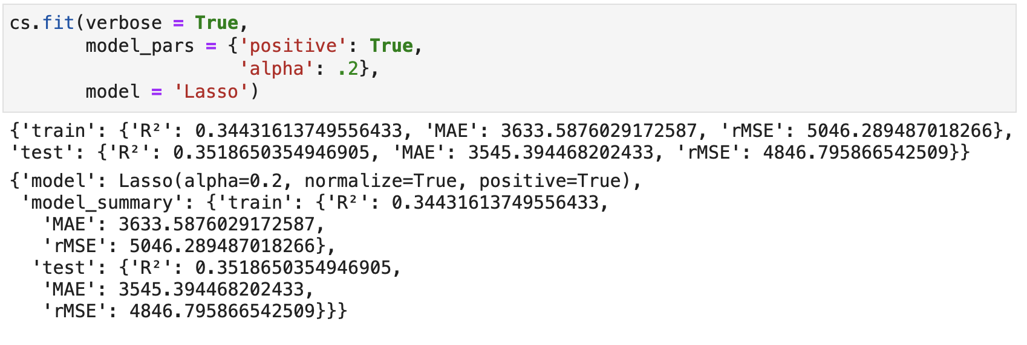
CommonScope Training

Slide 16
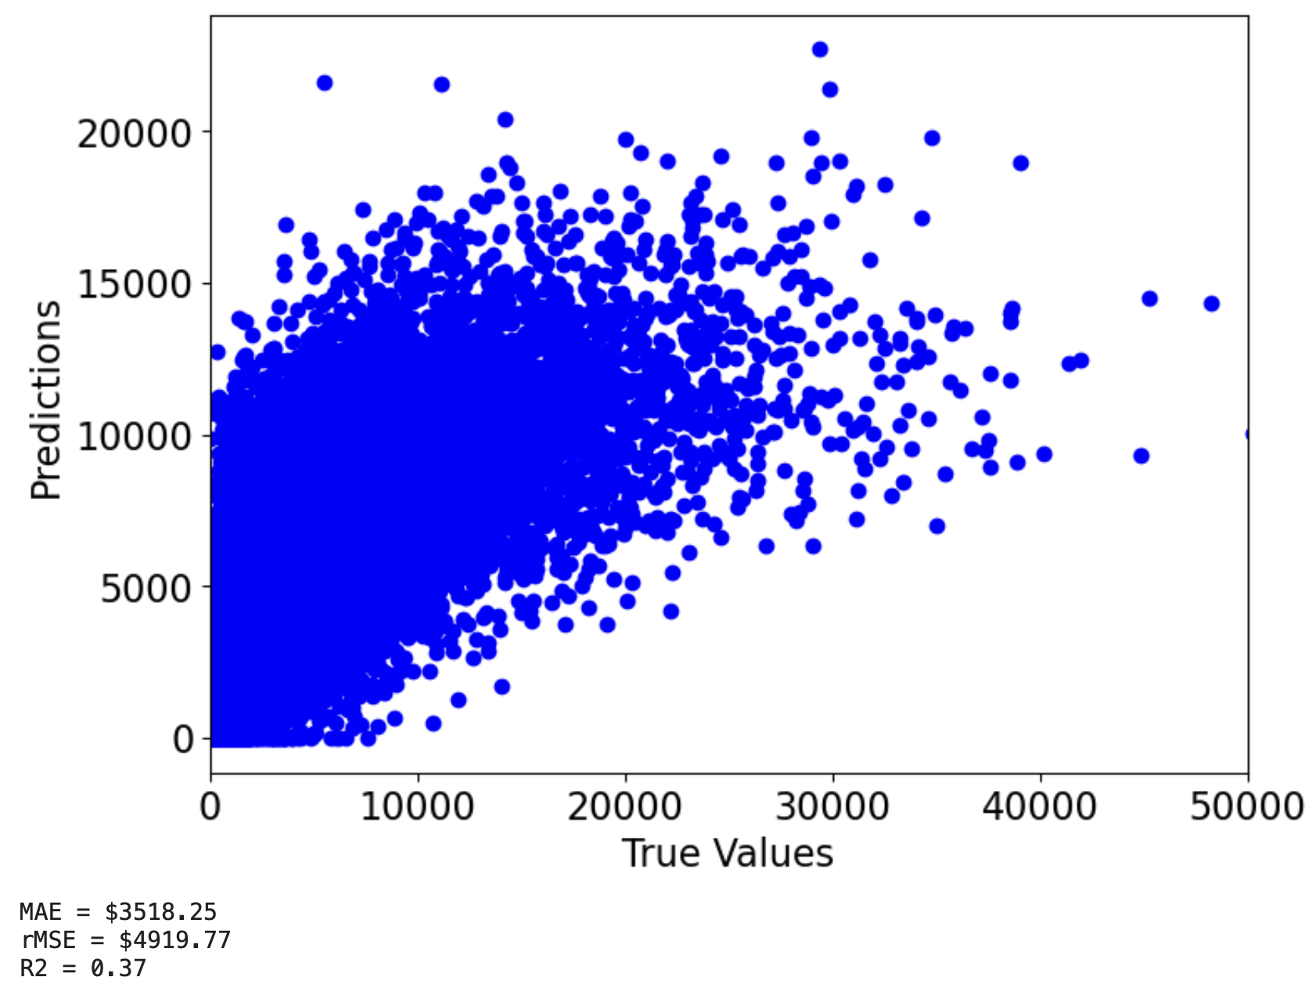
CommonScope Evaluation

Slide 17
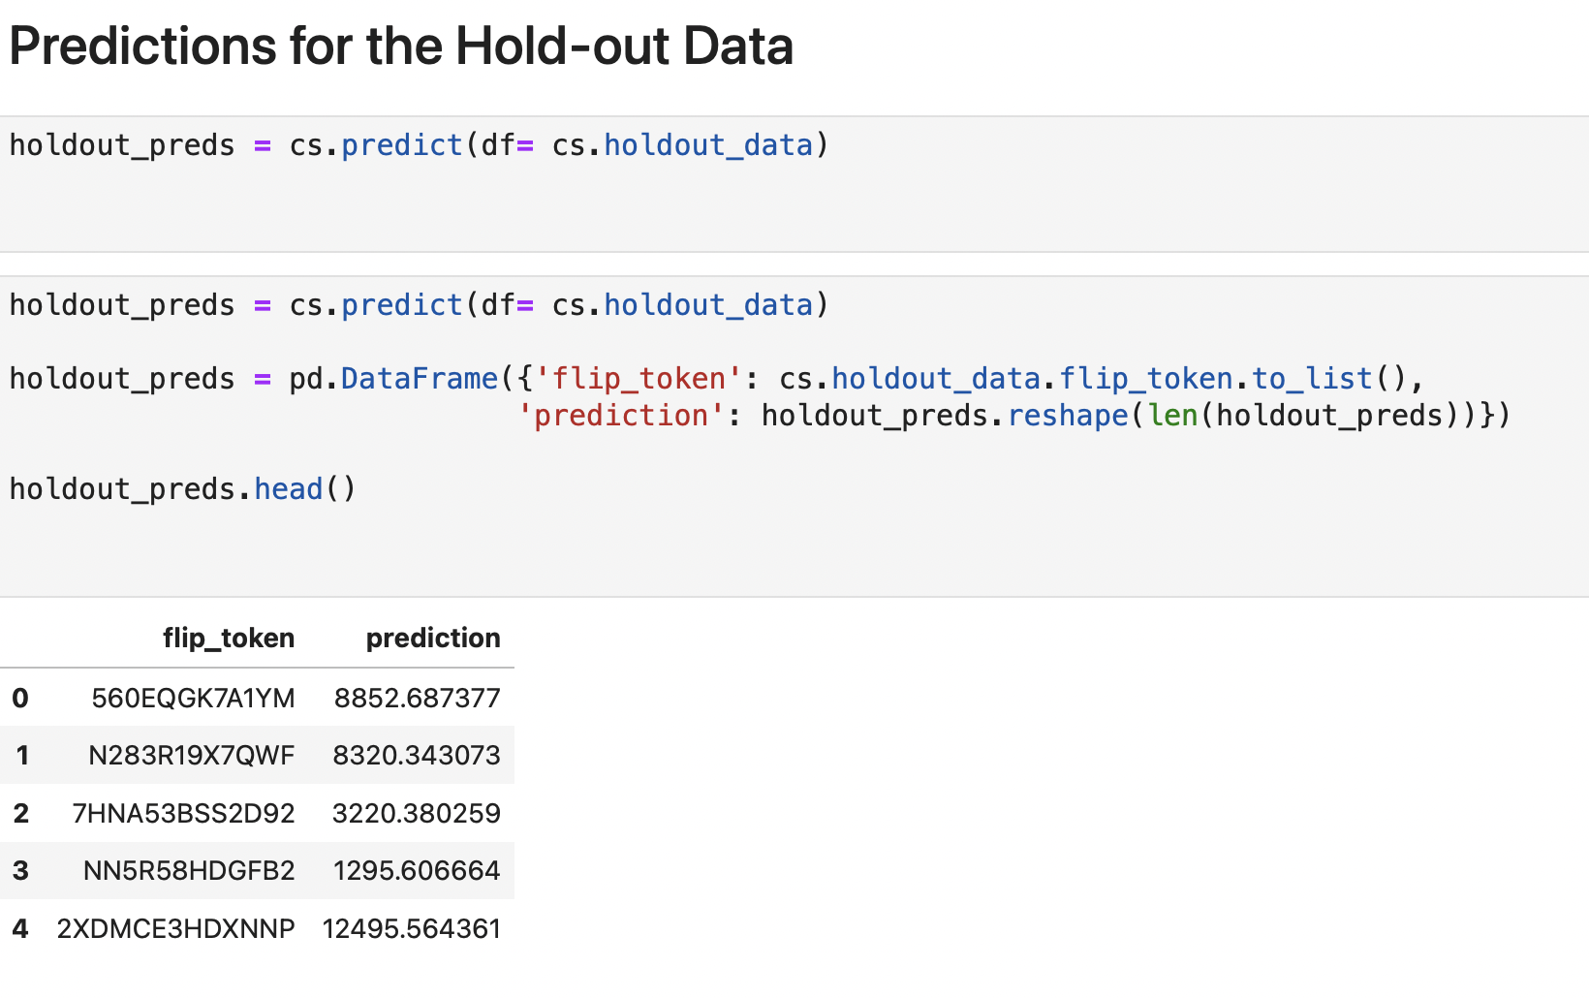
CommonScope Predictions

Slide 18
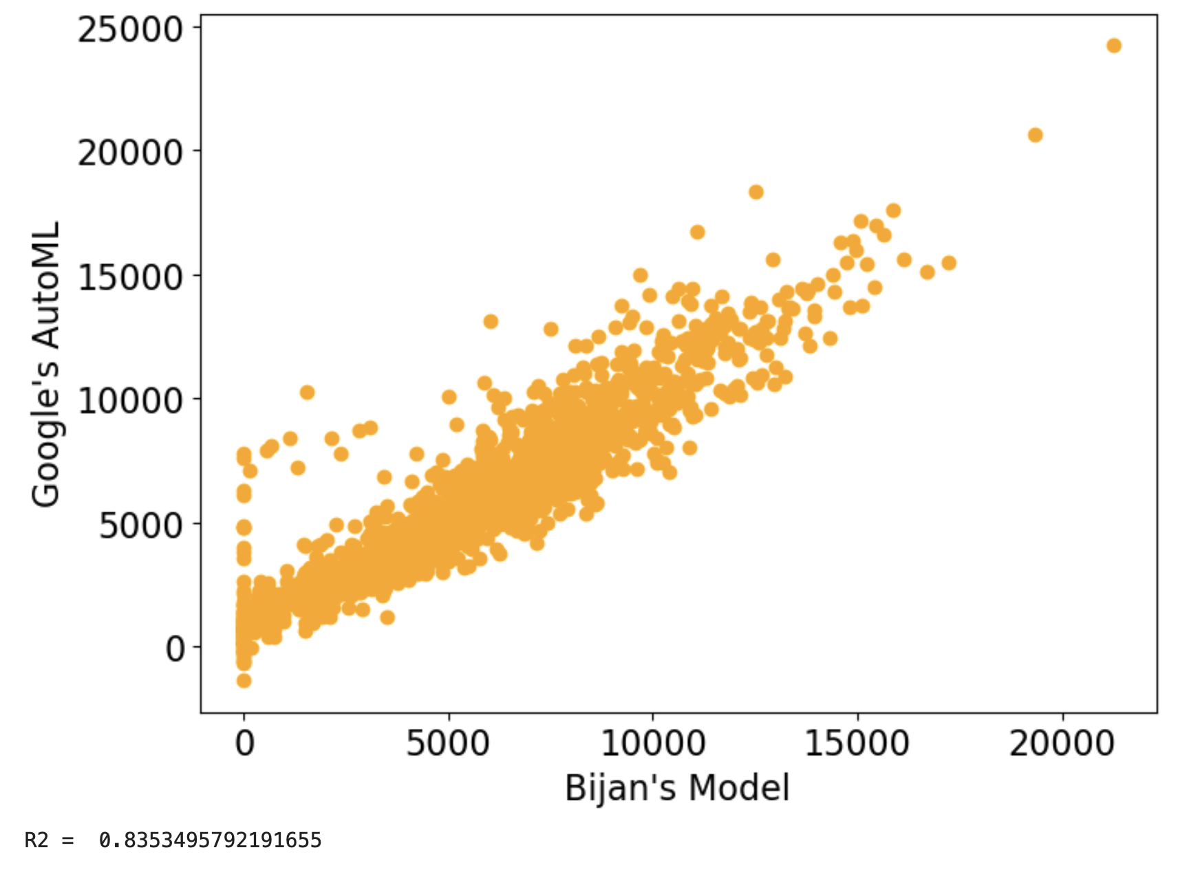
CommonScope vs. GCP’s AutoML

Slide 19
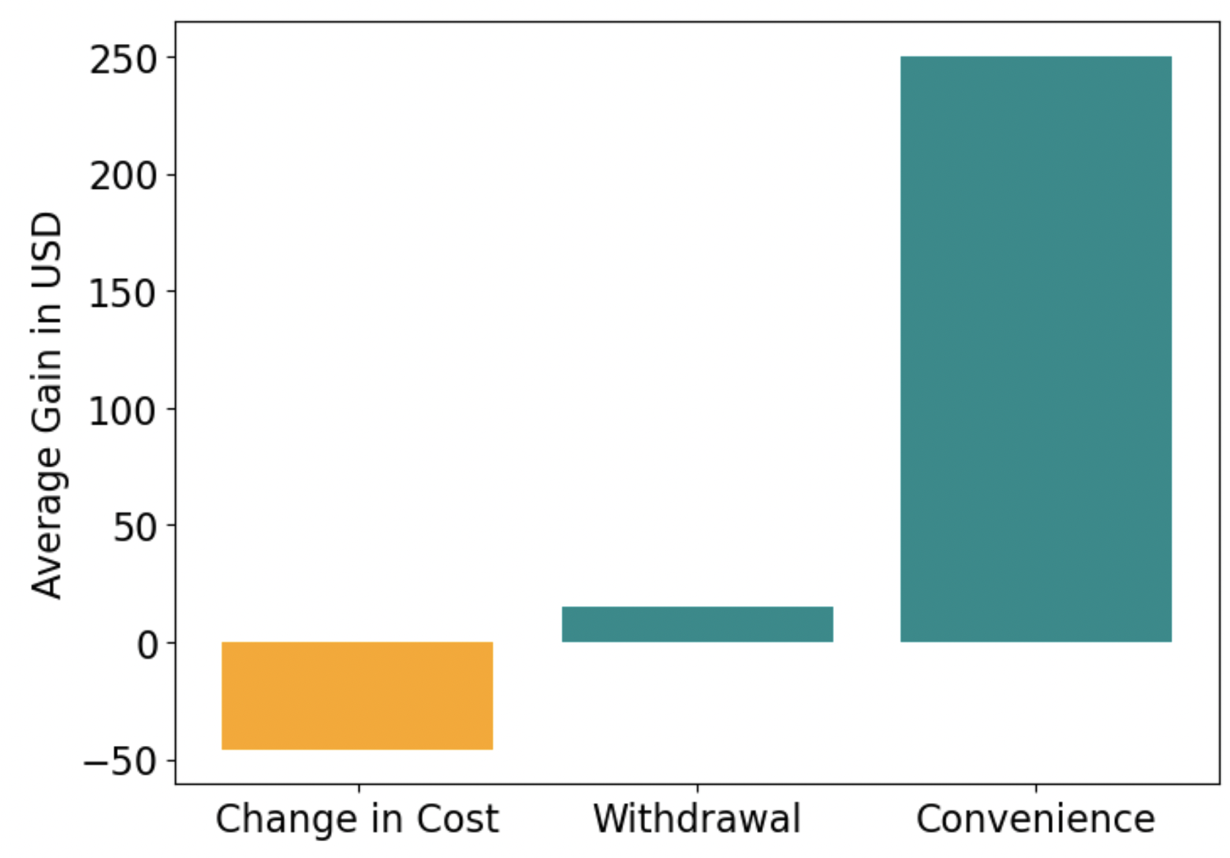
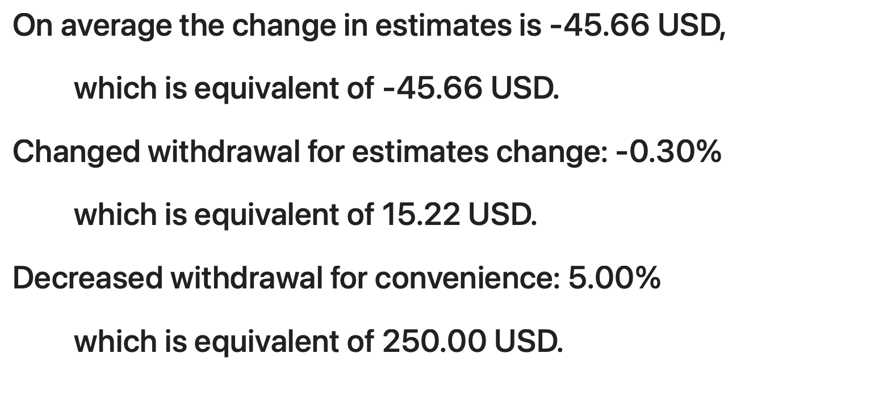
Analyzing for the Business Value

Slide 20
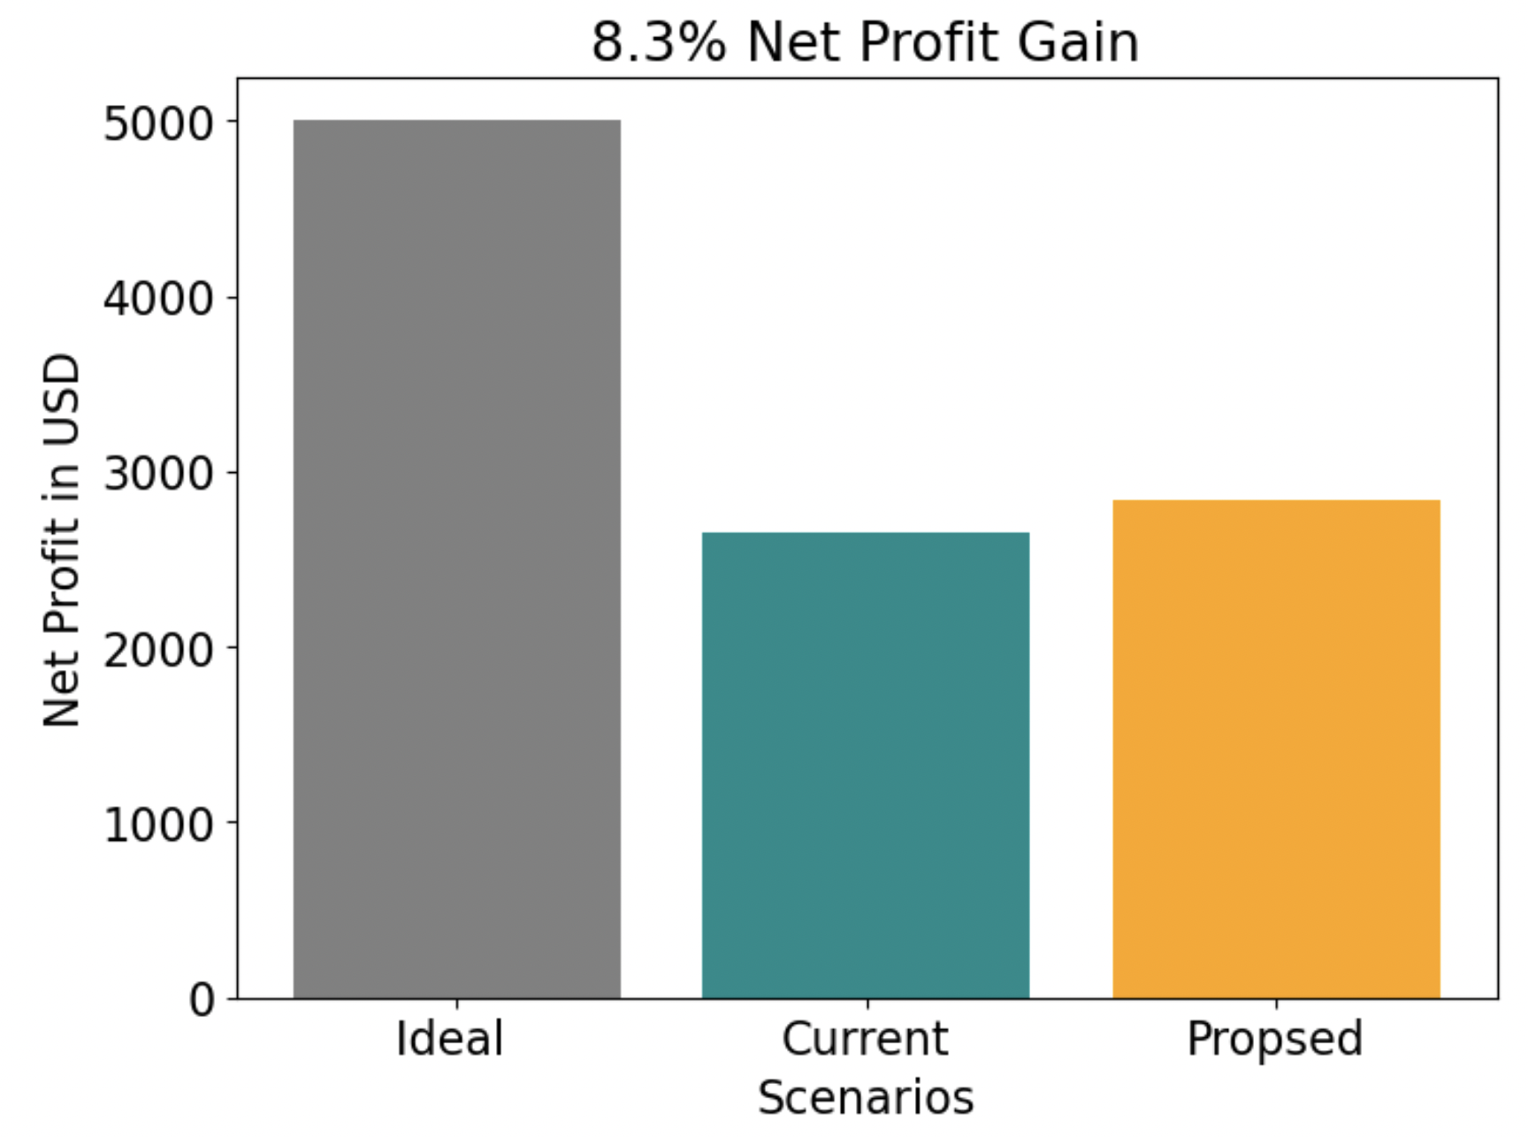
Analyzing for the Business Value

Slide 21
Road Map - V0 solution (1 Month)
- Improve data quality
- Increase the coverage
- Diversify the data as much as possible
- Utilize external datasets, especially localized datasets for each market
- Apply the new data data to th
- Report how the model predictions have (likely) improved with the new dataset
By the end of this milestone, an improved, more diverse and larger dataset is applied to the model.

Slide 22
Road Map - V1 solution (1 Quarter)
- Perform a sensitivity analysis of the model to each variable
- Identify the most important features interacting with each other
- Include interaction effects in the features
- Perform a model selection analysis such as Akaike Information Criterion
- Identify where (and possibly why) the model suffers the most
- Diagnose the model for underestimations at the higher end
By the end of this milestone, the model has been improved and an improved, more diverse and larger dataset is applied to the improved model.

Slide 23
Summary
The estimates from our crude model showed improvement over the manual inspection
There is business value as net profit in adopting an ML approach
Improving data quality / data quantity could lead to overall improvement
Strengthening the model’s weaknesses can improve the outcome

